Slide 1
SWE 4803
Lec - 1

Slide 2

Important For you
Course Code: SWE 4803
Course Name: Software Project Management
Text Books:
Software Project Management , Bob Hughes, Mike cotterell
Project Management for Information systems, James Cadle, Donald Yeates
Software project management: A unified framework, Walker Royce
Applied Software project management., Stellman, Andrew, and Jennifer Greene
Following the lecture slides & class will be good enough

Slide 3
Course Objective
Upon completion of this course you will be familiar with:
01
All the essential concepts of software project management
02
Project management processes that are essential to complete large project successfully
03
Successful planning, executing and completion of software project within budget and schedule.
NOT
to make you a Good project manager

Slide 4
Course Outcome(CO)
01
Explain the concepts of SW Project initiation & management for different organizational structure.
02
Prepare critical path and precedence network for a project.
03
Manage project resources, communication, stakeholders, risks, budget & quality with the help of suitable project management processes.

Slide 5
Lecture Plan
Weeks | Topics
1 | Introduction to project and software project management.
2 | Environment in which projects operate, Organizations, Project management styles, role of PM
3 | Project management processes
4 | develop project charter, project plan, Collect Requirements, Define Scope, project Scope Management
5 | Create WBS, Validate Scope, Control Scope, Plan Schedule Management, Define Activities, Sequence Activities, Estimate Activity Durations
6 | Develop Schedule, Control Schedule, Plan Cost Management, Estimate Costs, Determine Budget, Control Costs
7 | Plan Quality Management, Control Quality
8 | Plan Resource Management, Acquire Resources, Develop Team, Manage Team, Control Resources
9 | Plan Communications Management, Monitor Communications
10 | Plan Risk Management, Identify Risks, Perform Qualitative Risk Analysis, Perform Quantitative Risk Analysis,
11 | Plan Risk Responses, Implement Risk Responses, Monitor Risks
12 | Plan Procurement Management, Conduct Procurements, Control Procurements
13 | Identify Stakeholders, Plan Stakeholder Engagement, Manage Stakeholder Engagement, Monitor Stakeholder Engagement
14 | Review class

Slide 6



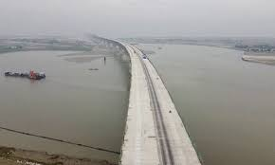



Project
Pyramids
Taj Mahal
Great Wall of China
Padma Bridge
Human landing on moon
Samsung Gear 360
BB1 satellite launching
Outcomes of these projects were the result of leaders and managers applying project management practices, principles, processes, tools, and techniques to their work.
The managers of these projects used a set of key skills and applied knowledge to satisfy their customers and other people involved in and affected by the project.

Slide 7
Project
A project is a temporary endeavor undertaken to create a unique product, service, or result.
    Temporary endeavor:
indicates that a project has a definite beginning and end.
does not necessarily mean a project has a short duration.
Projects are temporary, but their deliverables may exist beyond the end of the project.
    Unique product, service, or result.:
      Projects are undertaken to fulfill objectives by producing deliverables.
      Fulfillment of project objectives may produce one or more of the following deliverables:
        A unique product that can be either a component of another item
        A unique service (e.g., a business function that supports production or distribution);
        A unique result, such as an outcome or document (e.g., a research project that develops knowledge that can be used to determine whether a trend exists or a new process will benefit society);
        A unique combination of one or more products, services, or results (e.g., a software application, its associated documentation, and help desk services).

Slide 8
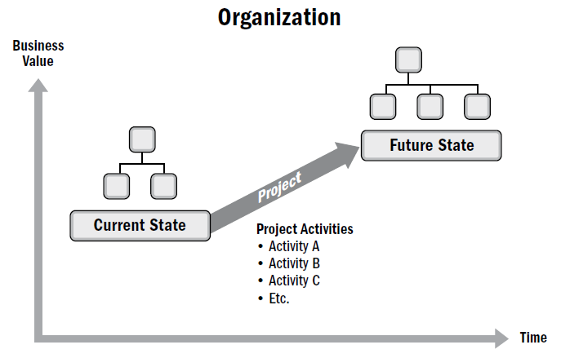
Project
    Projects drive change
    Projects enable business value creation
      Business value in projects refers to the benefit that the results of a specific project provide to its stakeholders.
      The benefit from projects may be tangible, intangible.
Monetary asset, tools, market share, etc..
Goodwill, Brand recognition, Reputation, etc..

Slide 9
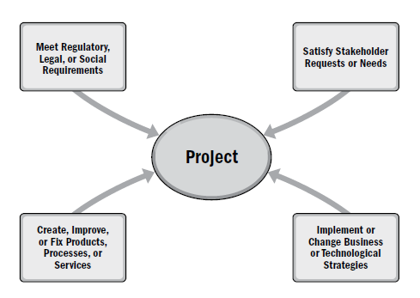
Project
    Why we initiate project
    Leaders respond to these factors in order to keep the organization viable.
    Projects provide the means for organizations to successfully make the changes necessary to deal with these factors.

Slide 10

Project
Meet Regulatory, Legal, or
Social Requirements
Implement or Change Business
or Technological Strategies
Create, Improve, or Fix Products,
Processes, or Services
Satisfy Stakeholder
Requests or Needs
    Specific Factors that Lead to the Creation of a Project
Specific Factor | Example
New technology | An electronics firm authorizes a new project to develop a faster, cheaper, and smaller laptop based on advances in computer memory and electronics technology
Competitive forces | Lower pricing on products by a competitor results in the need to lower production costs to remain competitive
Market demand | A car company authorizes a project to build more fuel-efficient cars in response to gasoline shortages
Customer request | An electric utility authorizes a project to build a substation to serve a new industrial park
Legal requirement | A chemical manufacturer authorizes a project to establish guidelines for the proper handling of a new toxic material
Strategic opportunity or business need | A training company authorizes a project to create a new course to increase its revenues
Social need | A nongovernmental organization in a developing country authorizes a project to develop an app to trace Covid patients..
Environmental considerations | A public company authorizes a project to create a new service for electric car sharing to reduce pollution

Slide 11
Project vs Operation
Operations are the day-to-day activities of the organization.
These are activities that are repetitive to the business.
They help in attaining the long-term goals of the business through repetitive output.
work
Change
Project
Ongoing
Operation
Unique
Temporary
Repetitive
Continuous
Not done before
Definite start and end
Identical replication
Not stop

Slide 12
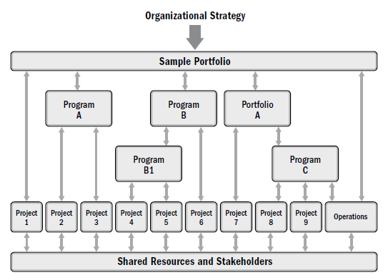
PROJECT – PROGRAM - PORTFOLIO
A program is a group of related projects, subsidiary programs, and program activities that are managed in a coordinated manner to obtain benefits not available from managing them individually.
A portfolio is a collection of projects, programs, subsidiary portfolios, and operations managed as a group to achieve strategic objectives.
Program and project management focus on doing programs and projects the “right” way;
Portfolio management focuses on doing the “right” programs and projects.

Slide 13
PROJECT – PROGRAM - PORTFOLIO
ABC Company
Portfolio
Sub Portfolio Z
Electrical projects
(Program X)
Construction
(Project A)
Telecom
(Project D)
IT projects
(Program Y)
Electrical distribution
(Project B)
App
development
(Project E)
SW
Maintenance
(Project F)
Electrical distribution
(Project C)

Slide 14

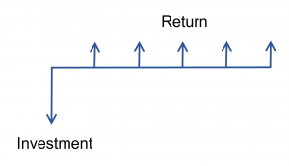
Project Selection
is this project on target to achieve the business benefits?
cost benefit analysis is a project selection method
compare a project’s costs and the benefits it provides
investment is made with an expectation of a return
Assume that someone offers to pay you one of two ways for some work you are doing for them: They will either pay you $1,000 now or $1,100 one year from now.
Which pay option should you take?

Slide 15
Project Selection
Time Value of Money Formula
Present Value:
PV = FV/ (1+r)^{n} r is the interest rate & n is duration
Suppose you have been promised by someone that he will give you 10,000.00 $, 5 year from today and interest rate is 8%. we want to know what the present value of 10,000.00 $ which you will receive in future
PV = 10,000/ (1+0.08)⁵
PV = 6805.83 (To the nearest Decimal)
So present-day value of $10,000.00 is $6805.83
Future Value:
FV = PV * (1+r)^{n}

Slide 16
Project Selection
Present Value
It is the current value of future cash flow or future value
What amount should we invest today to get a specific amount in future?
Investor can make decision whether to invest or reject the proposal with the help of PV
Future Value
It is the amount of money which will grow over period of time with simple or compound interest
If we invest some money today what will be the amount we get at future date
FV shows only future gain of total investment so the importance for investment decisions making is less

Slide 17
Project Selection
Return on investment (ROI)
ROI determines the potential profitability of an investment by calculating the benefits received in relation to the cost
ROI measure is used for knowing the potential earnings of an investment.
ROI is always expressed in a percentage form
Return on Investment Ratio = (Net Return / Cost of Investment) * 100
Example
A person wants to invest in the shares of a company. He purchased 100 shares at the price of $500 each and after sometime purchased 100 shares again of the same company at the price of $550 per share. After a few years, it sold all the 200 shares at the price of $600 per share. Calculate the return on investment ratio of the person.
Cost of Investment = Purchase Price *Quantity Purchased = $500 * 100 + $550 * 100 = $105,000
Net Return = Sales Value of Investment – Cost of Investment = (200*600) – $105,000 = $15,000
Return on Investment Ratio = (Net Return /Cost of Investment) * 100 = ($15,000 / $105,000) * 100 =14.29 %

Slide 18
Project Selection
Net Present Value (NPV):
Net present value is the present value of the cash flows at the required rate of return of your project compared to your initial investment,
NPV considers the time value of money, translating future cash flows into today’s dollars.
Formula For the Net Present Value is given below:
    NPV = ∑(CF_{n} / (1 + i)^{n}) – Initial Investment
Where,
n = Period which takes values from 0 to the nth period till the cash flows ends
CF_{n} = Cash flow in the n^{th} period
i = Discounting rate/interest rate
In practical, NPV a method of calculating your return on investment for a project or expenditure.
Based on the results of the Net Present Value, a company may decide on investing in one project and rejecting another.

Slide 19
Project Selection
Net Present Value(NPV):
Assuming the initial investment is $10,000 invested for a project and subsequent cash flows for each year for 5 years is $3,000. The discount rate is assumed to be 10%. Calculate Net Present Value.
NPV = ∑(CF_{n} / (1 + i)^{n}) – Initial Investment
PV
PV₁ = FV₁/ (1+r)^{n} = 3000/(1+0.1)¹ = 2727.27
PV₂ = FV₂/ (1+r)n = 3000/(1+0.1)² = 2479.34
PV₃ = FV₃/ (1+r)^{n} = 3000/(1+0.1)³ = 2253.94
PV₄ = FV₄/ (1+r)^{n} = 3000/(1+0.1)⁴ = 2049.04
PV₅ = FV₅/ (1+r)^{n} = 3000/(1+0.1)⁵ = 1862.76
NPV = ∑(CF_{n} / (1 + i)^{n}) – Initial Investment = ($2,727.27 + $2,479.34 + $2,253.94 + $2,049.04 + $1,862.76) – $10,000
= $1372.36

Slide 20
Project Selection
Lets assume you have a software project that requires an initial investment of $10,000, and it is expected to generate cash flows of $3,000 at the end of each year for three years. The discount rate is assumed to be 10%.
NPV = ∑(CF_{n} / (1 + i)^{n}) – Initial Investment
PV
PV₁ = FV₁/ (1+r)^{n} = 3000/(1+0.1)¹ = 2727.27
PV₂ = FV₂/ (1+r)n = 3000/(1+0.1)² = 2479.34
PV₃ = FV₃/ (1+r)^{n} = 3000/(1+0.1)³ = 2253.94
NPV = ∑(CF_{n} / (1 + i)^{n}) – Initial Investment = ($2,727.27 + $2,479.34 + $2,253.94) – $10,000
= - $1539.45
the present value of the expected cash flows does not cover the initial investment

Slide 21
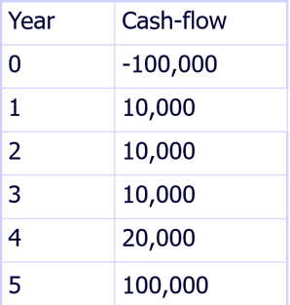
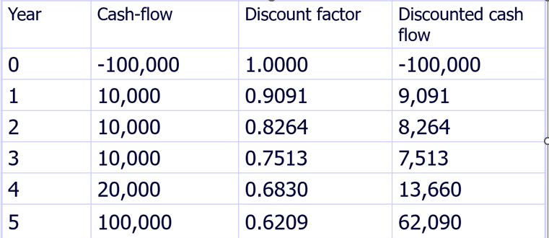
Project Selection
Discount rate
Discount rate = 1/(1+r)^{t}
  r is the interest rate (e.g. 10% is 0.10)
  t is the number of years
In the case of 10% rate and one year, Discount factor = 1/(1+0.10) = 0.9091
In the case of 10% rate and two years, Discount factor = 1/(1.10 x 1.10) =0.8294

Slide 22
Project Selection
Net Present Value (NPV):
General Electric has the opportunity to invest in 2 projects. Project A requires an investment of $1000000 which will give a return of $300000 each year for 5 years. Project B requires an investment of $750000 which will give a return of $100000, $150000, $200000, $250000 and $ 250000 for the next 5 years. Then Calculate the Net Present Value which can be used to decide which opportunity is better and should be invested in.
Calculate the NPV for Project A
Calculate the NPV for Project B
Chose the project with bigger NPV

Slide 23
Project Selection
Internal rate of return(IRR):
Internal Rate of Return is the discount rate that makes the Net Present Value zero.
is usually used to calculate the profitability of investments made in a financial product or projects
For project selection go with larger IRR
Relation between the discount rate and IRR :
If Discount Rate < IRR:
  The project is expected to be more profitable than the cost of capital. It implies that the project is considered financially attractive.
If Discount Rate > IRR:
  The project is expected to be less profitable than the cost of capital. This suggests that the project might not be financially viable.
If Discount Rate = IRR:
  The project breaks even; the present value of cash inflows equals the present value of cash outflows. This is the point where NPV is zero.

Slide 24

Project Selection
Payback Period:
The payback period is the time required to recover the cost of total investment meant into a business.
is used for taking decisions whether a particular project will be taken by the organization or not.
In simple terms, management looks for a lower payback period.
payback period ignores the time value of money.

Slide 25
Project Selection
Payback Period:
A particular Project Cost USD 1 million, and the profitability of the project would be USD 2.5 Lakhs per year. Calculate the Payback Period in years.
= 1 million /2.5 lakh
= 4 years

Slide 26
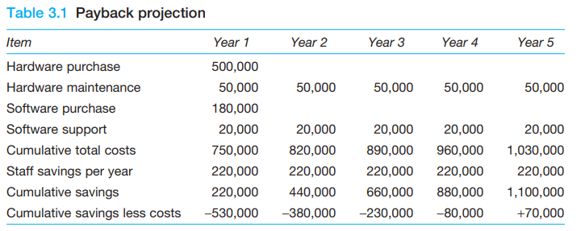
Project Selection
Payback Period:
Let us suppose that we are trying to justify a project to install a new computer system that will eliminate some clerical jobs. The basic facts are these:
  The hardware will cost £500,000.
  Hardware maintenance will cost £50,000 per annum.
  The software will cost £180,000 initially.
  Software support will cost £20,000 per annum.
  We expect to save 11 junior clerical posts which, with overhead costs included, are worth £20,000 each per annum (£220,000 per annum overall).

Slide 27
Project Selection
Benefit-Cost Ratio (BCR):
“Benefit-Cost Ratio” refers to the financial metric that helps in assessing the viability of an upcoming project based on its expected costs and benefits.
Benefit-Cost Ratio = PV of Expected Benefits / PV of Expected Costs
a company recently invested $10,000 for the purpose of replacing some of its production server with high performance. This is expected to result in incremental benefits of $5,000 in 1st year, $3,000 in 2nd year and $4,000 in 3rd year. Calculate the benefit-cost ratio of the replacement project if the applicable discounting rate is 5%.
PV of benefit in 1st year = $5,000 / (1 + 5%)¹ = $4,761.90
PV of benefit in 2nd year = $3,000 / (1 + 5%)² = $2,721.09
PV of benefit in 3rd year = $4,000 / (1 + 5%)³ = $3,455.35
PV of Expected Benefits = $4,761.90 + $2,721.09 + $3,455.35 = $10,938.34
Benefit-Cost Ratio = PV of Expected Benefits / PV of Expected Costs =$10,938.34 / $10,000 = 1.09
the benefit-cost ratio of the project is 1.09 which indicates that it will create additional value and it should be considered positively.
BCR<1 is bad. Project with bigger BCR is better.

Slide 28


Project Selection
Let’s do some simple exercise:
 | Project A | Project B | Which project to select
NPV | $95000 | $75000
IRR | 13% | 17%
Payback Period | 16 months | 21 months
BCR | 2.76 | 1.3

Slide 29
IS projects
Software development
Package implementation
System enhancement
Consultancy and business analysis assignments
Systems migration
Infrastructure implementation
Outsourcing (and in-sourcing)
Disaster recovery
Smaller IS projects

Slide 30
SW Development Project vs Other Project
    The product of software project have certain characteristics which make them different.
      Invisibility: When a physical artifact such a bridge or road is being constructed the progress being made can actually be seen. With software, progress may not be immediately visible.
      Complexity: Per dollar, pound or euro spent, software products contain more complexity than other engineered artifacts.
      Conformity: The traditional engineer is usually working with physical systems and physical materials like cement and steel. These systems can have some complexity but are governed by consistent physical laws. Software developers have to conform to the requirements of human clients that certainly keep on fluctuating.
      Flexibility: The ease with which software can be changed is usually seen as one of its strengths. Software systems are subject to a high degree of change.

Slide 31
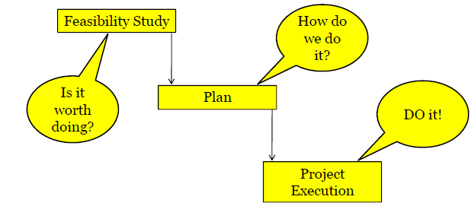
Major activities of SW Project
    A software project is not only concerned with the actual writing of code.
    Three successive processes bring a new system

Slide 32
Problems with Software Project
Commonly experienced problems
  • Inadequate specification of work
  • Management’s ignorance of IT
  • Lack of knowledge of the application area
  • Lack of standard
  • Lack of up-to-date documentation
  • Narrow scope of technical expertise
  • Changing software environment
  • Deadline pressure
  • Lack of quality control
  • Remote management
  • Lack of training
  • Lack of communication between users and technicians
  • Lack of commitment
  There are many more…..

Slide 33
Project Success and failure
Project success can be defined as the achievement of something desired, planned, or attempted. success is an event that accomplishes its intended purpose.
Anything short of the intended purpose is failure.
CAUSES OF PROJECT FAILURES
Lack of Senior management support
Poor communication
Inadequate resources
No one is in control
Poor definition of Scope
Project lacks structure
Inaccurate estimates
Poor risk management
Unrealistic Milestones
Incompetent project management skill

Slide 34
Project Success and failure
How to define success criteria ?
Project success criteria are the standards by which the project will be judged at the end to decide whether or not it has been successful in the eyes of the stakeholders.
Success criteria for a successful project
Within the allocated time period
Within the budgeted cost
At the proper performance or specification level
With acceptance by the customer/user
With minimum or mutually agreed upon scope changes
Without disturbing the main work flow of the organization
Without changing the corporate culture
80% percent of successful projects have an experienced project manager

Slide 35
SW Project Management
Is the art and science of planning a leading the SW projects
Effective SW Project management focuses on four P’s:
People:
The most important element of a successful project
Software Engineering Institute has developed a People Management Capability Maturity Model (PM-CMM), “to enhance the readiness of software organizations to undertake increasingly complex applications by helping to attract, grow, motivate, deploy, and retain the talent needed to improve their software development capability”.
SW Project Management
People
Product
Process
Project

Slide 36
SW Project Management
Is the art and science of planning a leading the SW projects
Effective SW Project management focuses on four P’s:
People:
PM-CMM focuses on :
  Recruiting
  Performance
  Training
  Compensation
  Career development
  Team and work culture development
And the people consist of
  Stakeholders
  Team lead
  SW team
SW Project Management
People
Product
Process
Project
Make sure the right people join, grow, stay happy, and do the right work so the company can build better software.

Slide 37
SW Project Management
SW Project Management
People
Product
Process
Project
Product:
result of the project
product scope need to be clearly defined so that every stakeholder is clear on the end results.
The product refers to be both tangible and intangible.
For example, it could mean relocating the office or factory to a new premise or migrating to a new software/tool.

Slide 38
SW Project Management
SW Project Management
People
Product
Process
Project
Process:
A clearly defined process is the key to the success of any project.
Each stage of the process in the project needs to be mapped so that everyone knows what to do and how to do it.
The correct process strategy leads to the proper execution of the project

Slide 39
SW Project Management
Project:
Key component of development
Project Manager (PM) leads the project
Oversees overall progress
Assigns tasks to team members
Guides and supports the team
Monitors budget
Ensures deadlines are met
SW Project Management
People
Product
Process
Project

Slide 40
SW Project Management
Project:
5W2H Principle
A series of question that leads to a definition of key project characteristic and the resultant project plan
  Why is the system being developed?
    Business viability
  What will be done?
    Product backlog
  When will be done?
    Schedule
  Where are they organizationally located?
    Location of team and other stakeholders
  Who is responsible?
    define role and responsibility
  How will the job be done technically and managerially?
    Technical and management strategy
  How much of each resource is required?
    Estimates based on the answers of the previous questions
SW Project Management
People
Product
Process
Project

